Slide 1
Phantom of the ADAS: Phantom Attacks on Driver-Assistance Systems. IACR’20
Nassi, Ben, Dudi Nassi, Raz Ben-Netanel, Yisroel Mirsky, Oleg Drokin, and Yuval Elovici.

Slide 2
Motivation
An attacker as any malicious entity with a medium sized budget (a few hundred dollars is enough to buy a drone and a portable projector) and the intention of creating chaos by performing a phantom attack that will result in unintended car behavior.

Slide 3
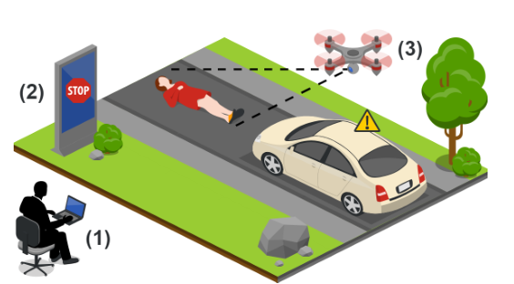
Threat Model
The Threat Model: An attacker
either remotely hacks a digital billboard
or flies a drone equipped with a portable projector
to create a phantom image.

Slide 4


Threat Model
Various factors that influence the success rate of phantom attacks:
Projection size：
Projection intensity：

Slide 5
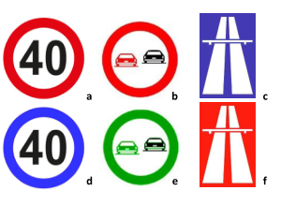
Threat Model
Disguise phantom attacks:
Assess whether Mobileye is sensitive to the color of the sign:
Determine the minimal projection time required to ensure that Mobileye detects the phantom: More than 125 ms for Mobileye.

Slide 6
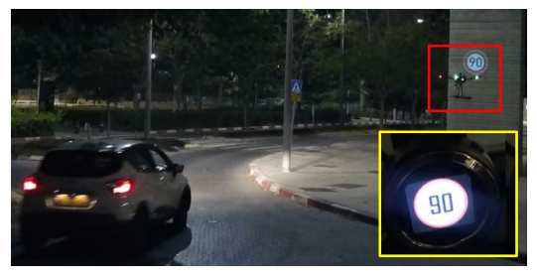
Threat Model
Attack evaluation for Mobileye:
a drone delivery

Slide 7
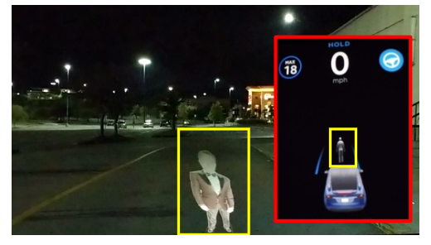
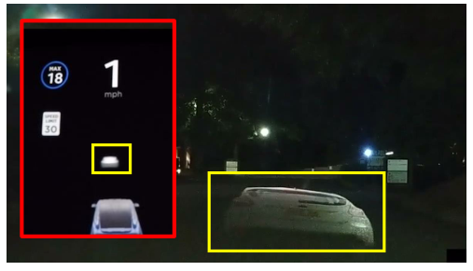
Threat Model
Phantom attacks on semi-autonomous cars(Tesla):
Semi-autonomous cars: obstacle detection system obtains information about its surroundings from eight surround video cameras, twelve ultrasonic sensors, and front-facing radar .

Slide 8
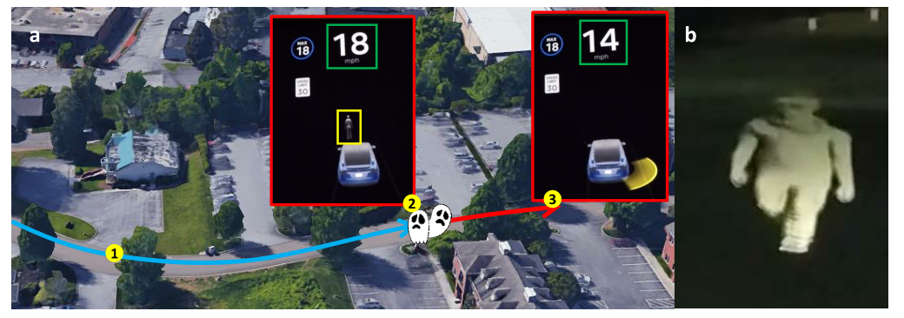
Threat Model
Fooling the lane detection system:

Slide 9
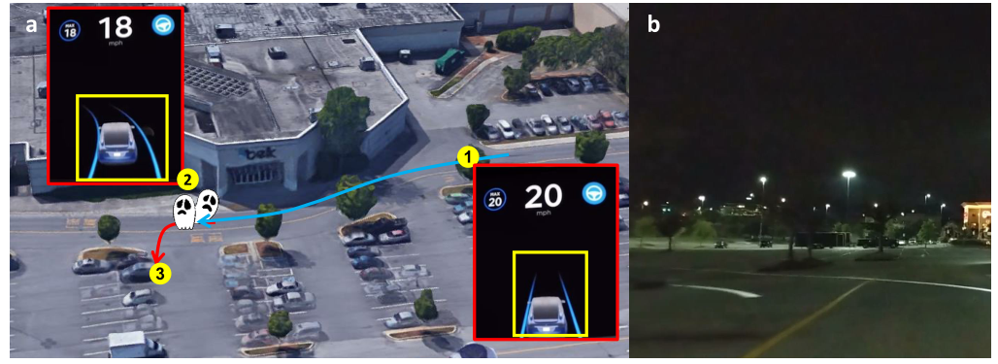
Threat Model
Fooling the obstacle detection system:

Slide 10
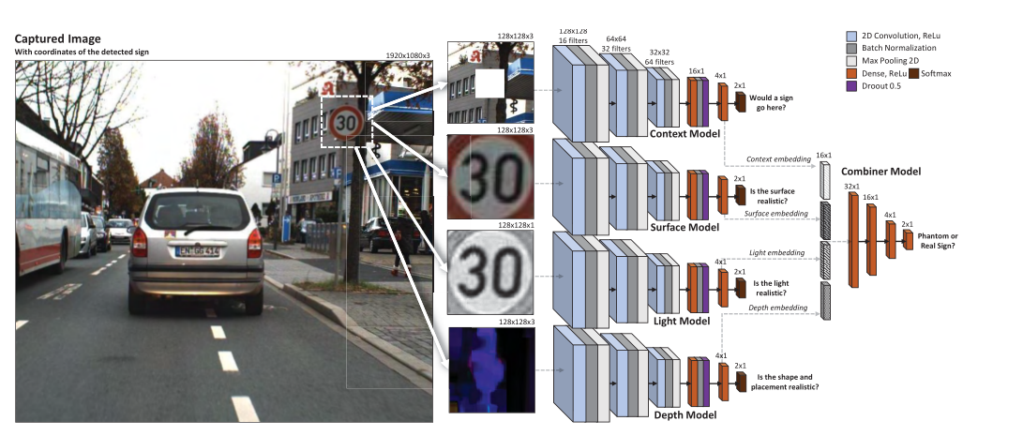
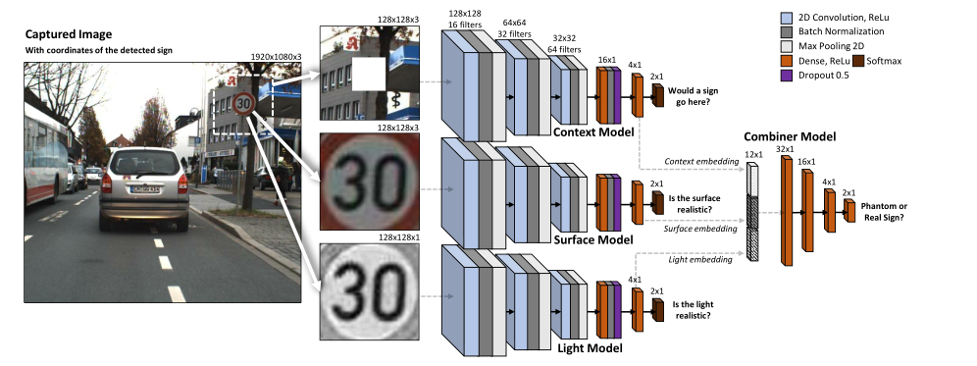
Detection Model

Slide 11
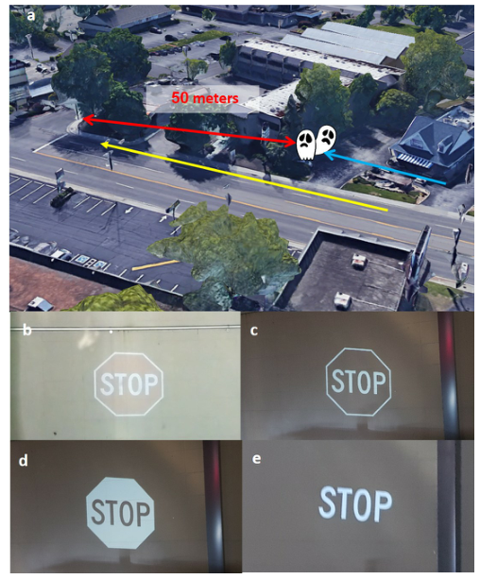
Appendix
Fooling Tesla’s Road Sign Recognition System:
this mechanism uses an internal database (without the use of the video camera) which is queried with location and orientation data in order to obtain the necessary information regarding traffic laws on a given road.
In the testing phase:

Slide 12
Discussion
1. better safe than sorry
2. most places around the world don’t utilize V2I systems at all
3. this fact can be used to perform a Turing test

